Slide 1
Predicting Default in Peer-to-Peer Lending
Evan Generoli
Bayesian Statistics
University of Colorado Denver

Slide 2
Introduction
People don’t like risk/uncertainty
Particularly when it comes to their finances
Investors like to know how risky an asset is before investing in it
There is demand for predicting the likelihood of loan default based on available information
I analyze Lending Club loan data and build a model to predict default

Slide 3
Background
Lending Club is a Peer-to-Peer (P2P) lending company
P2P lending companies act as middlemen matching investors with borrowers seeking personal loans
Somewhat like “the UBER of personal loans”
Reduced overhead compared to banks provides better terms to both borrowers & investors

Slide 4
Data
Complete dataset of all Lending Club loans issued from 2007-2018
Original dataset was about 890,000 observations
I selected only those loans whose terms have finished, leaving only settled loans (ie. fully paid or written off) ~ 380,000 loans met this criteria
For computational feasibility, I took a random sample of n = 1000 observations

Slide 5
Research Questions
Does home ownership substantially reduce the probability of default?
How strong is annual income as a predictor of default? (likely an inverse relationship)
Is length of employment or age of oldest credit line a better predictor of default?

Slide 6
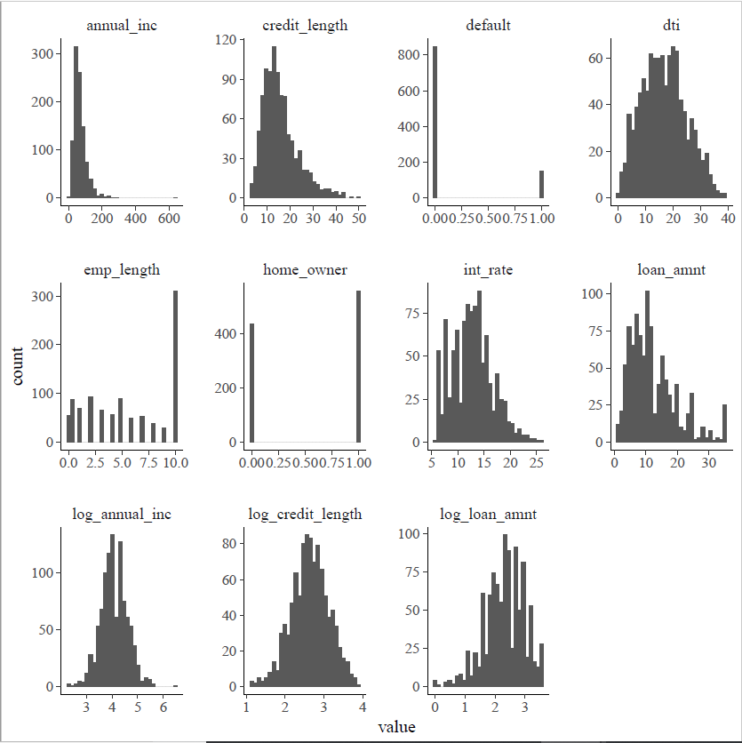

Slide 7
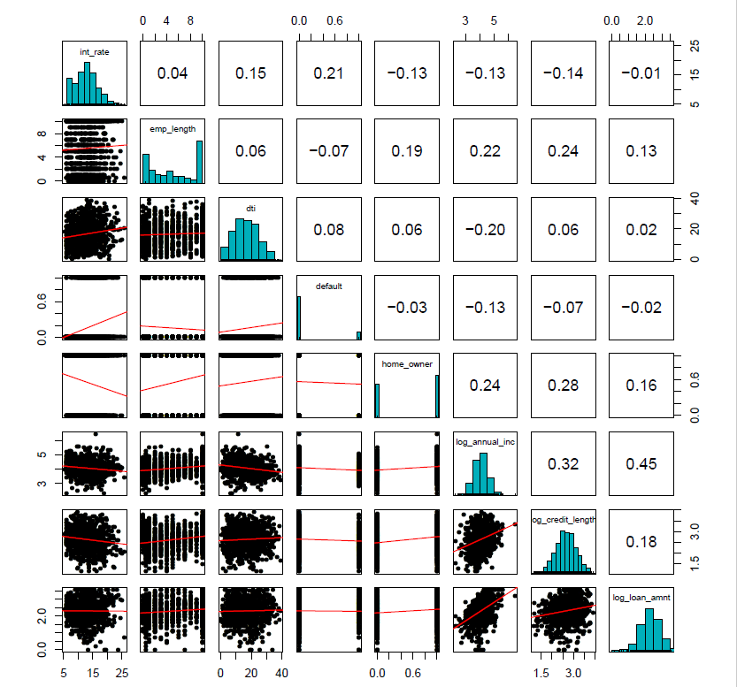

Slide 8
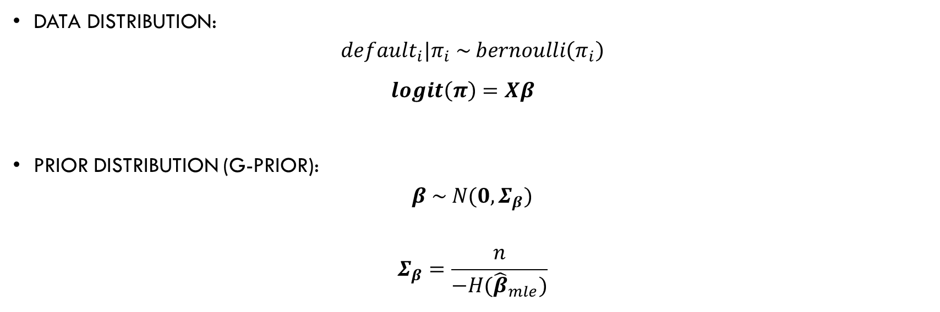
Model
Data distribution:
$$default_{i}|π_{i} \sim bernoulli\left(π_{i}\right)$$
$logit\left(π\right)=Xβ$
Prior distribution (g-prior):
$$β \sim N(0, Σ_{β})$$
$$Σ_{β}=\frac{n}{−H({\hat{β}}_{mle})}$$

Slide 9
Model Selection – forward Stepwise Selection
Variables in Model | WAIC
Interest Rate | 812.074
Employment Length | 851.8296
Debt-to-Income Ratio | 849.2093
Home Owner | 855.4523
Log(Annual Income) | 840.122
Log(Credit Length) | 851.7088
Log(Loan Amount) | 856.2157
Interest Rate + Employment Length | 807.7218
Interest Rate + Debt-to-Income Ratio | 810.838
Interest Rate + Home Owner | 813.9563
Interest Rate + Log(Annual Income) | 802.3916
Interest Rate + Log(Credit Length) | 812.5074
Interest Rate + Log(Loan Amount) | 813.5095
Interest Rate + Log(Annual Income) + Employment Length | 801.8712
Interest Rate + Log(Annual Income) + Debt-to-Income Ratio | 803.0758
Interest Rate + Log(Annual Income) + Home Owner | 804.2344
Interest Rate + Log(Annual Income) + Log(Credit Length) | 804.4707
Interest Rate + Log(Annual Income) + Log(Loan Amount) | 803.5515
Interest Rate + Log(Annual Income) + Employment Length + Debt-to-Income Ratio | 801.9076
Interest Rate + Log(Annual Income) + Employment Length + Home Owner | 803.3039
Interest Rate + Log(Annual Income) + Employment Length + Log(Credit Length) | 803.7277
Interest Rate + Log(Annual Income) + Employment Length + Log(Loan Amount) | 802.6592
All models were fit with 3 chains of 10,000 iterations each (1st half discarded as warmup)
All of the Gelman-Rubin statistics were between 0.9998549 & 1.0024992, suggesting convergence

Slide 10
Selected Model
$$logit\left(π_{i}\right)=β_{1}+β_{2}\text{Interest} \text{Rate} \text{ + }β_{3}\text{Log}\text{(}\text{Annual} \text{Income}\text{) + }β_{4}\text{Employment} \text{Length}$$

Slide 11
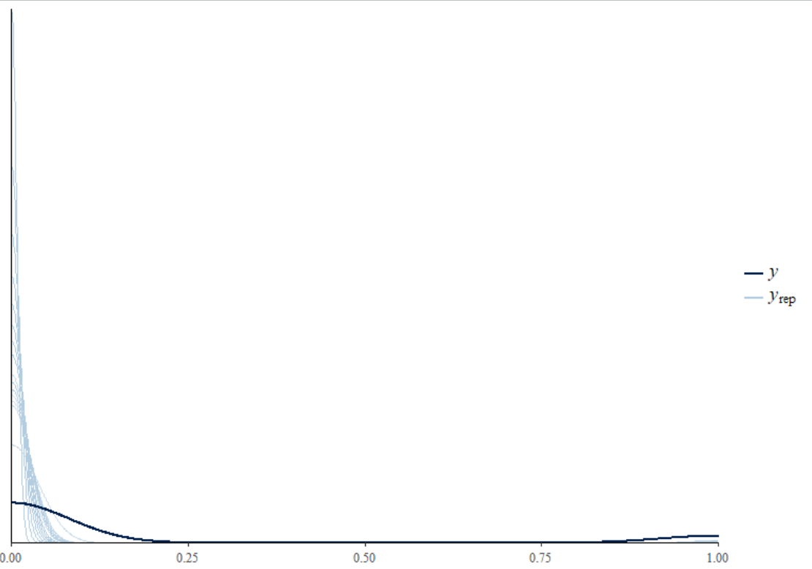
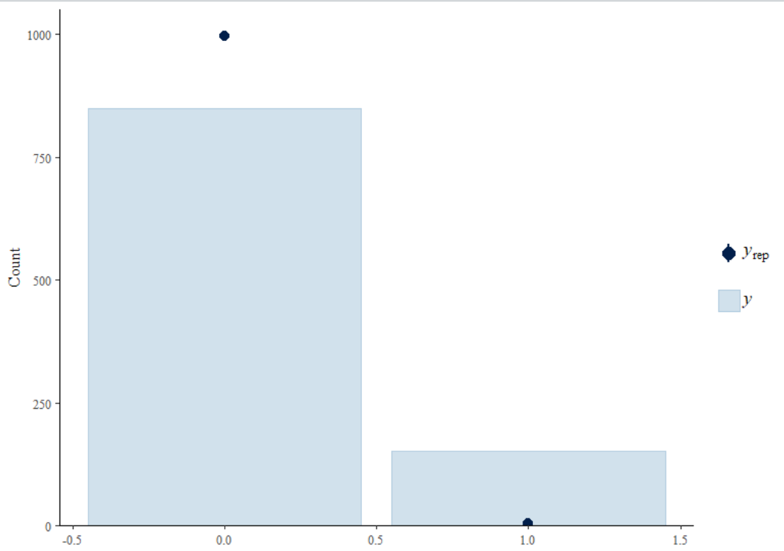
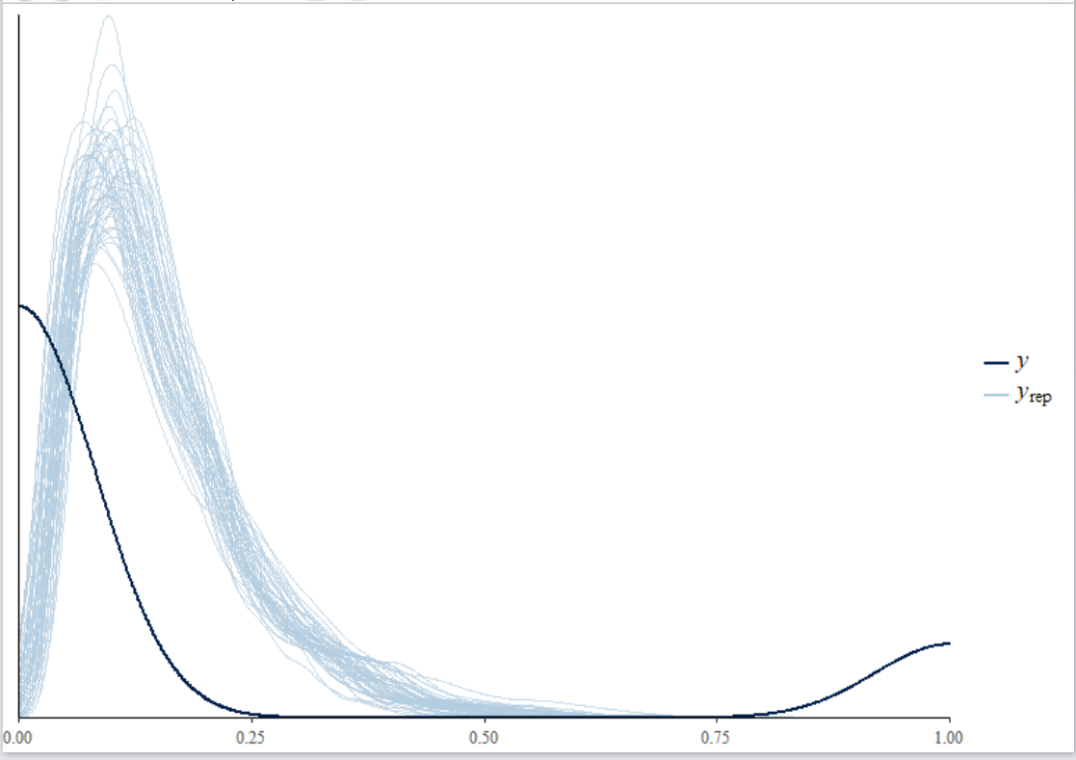
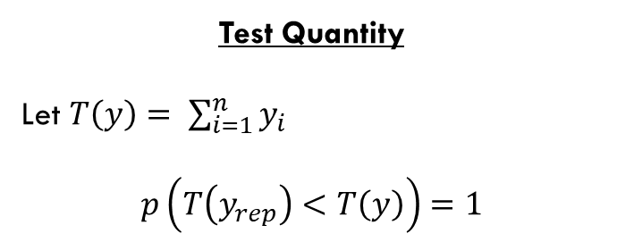
Posterior Predictive Checks
Rounded to 0/1
Probabilities
Test Quantity
Let $T\left(y\right)= \sum_{i=1}^{n}{y_{i}}$
$$p\left(T\left(y_{rep}\right)<T\left(y\right)\right)=1$$

Slide 12
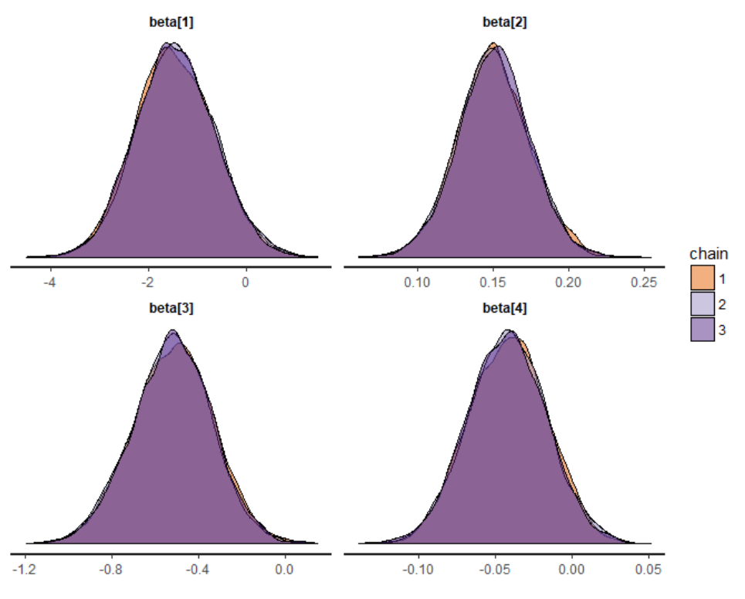
Results
 | Mean | Median | 2.5% | 97.5%
beta[1] | -1.451 | -1.469 | -2.996 | 0.158
beta[2] | 0.151 | 0.15 | 0.104 | 0.198
beta[3] | -0.522 | -0.517 | -0.892 | -0.162
beta[4] | -0.042 | -0.042 | -0.092 | 0.008
exp_beta[1] | 0.325 | 0.23 | 0.05 | 1.171
exp_beta[2] | 1.163 | 1.162 | 1.109 | 1.219
exp_beta[3] | 0.604 | 0.596 | 0.41 | 0.851
exp_beta[4] | 0.959 | 0.959 | 0.912 | 1.008

Slide 13
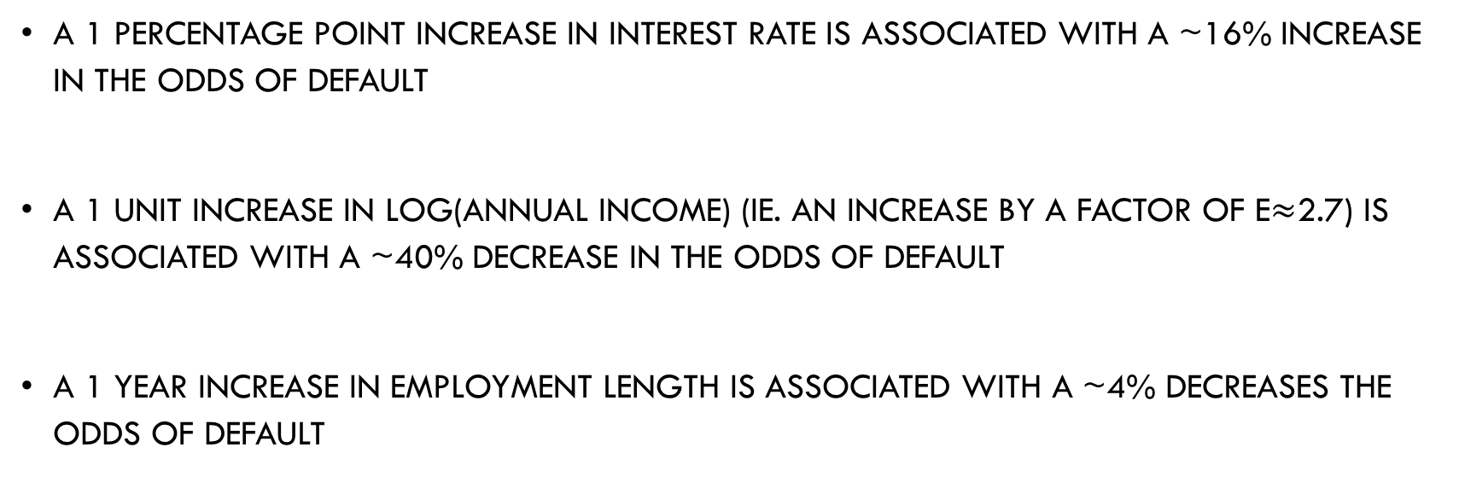
Interpreting Results
A 1 percentage point increase in interest rate is associated with a ~16% increase in the odds of default
A 1 unit increase in Log(Annual Income) (ie. an increase by a factor of e$≈$2.7) is associated with a ~40% decrease in the odds of default
A 1 year increase in Employment Length is associated with a ~4% decreases the odds of default

Slide 14
Conclusions
Home ownership does not seem to be a particularly strong predictor of loan default in this dataset (not strong enough to end up in the final model)
Annual Income is quite strong at predicting loan default
Employment Length appears to be a stronger predictor of loan default than Age of Oldest Credit Line

Slide 15
Conclusions
Bayesian data analysis is not well suited to large datasets and/or complex models
Need more variables
Need more computing power/memory to use larger sample size
Faster computer, cloud services, SQL database?

